Slide 1
Progress
Shayarneel Kundu
Michael Cardiff

Slide 2
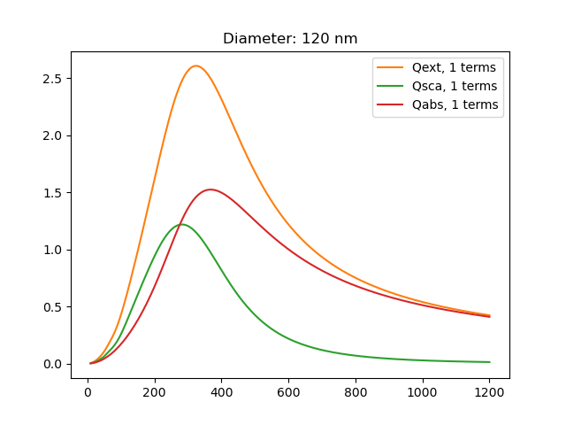
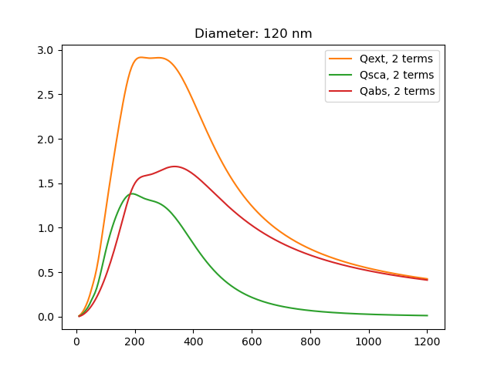
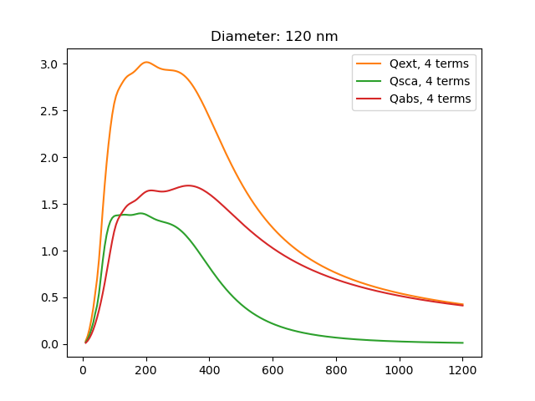

n = 1, 2, 3, 4

Slide 3
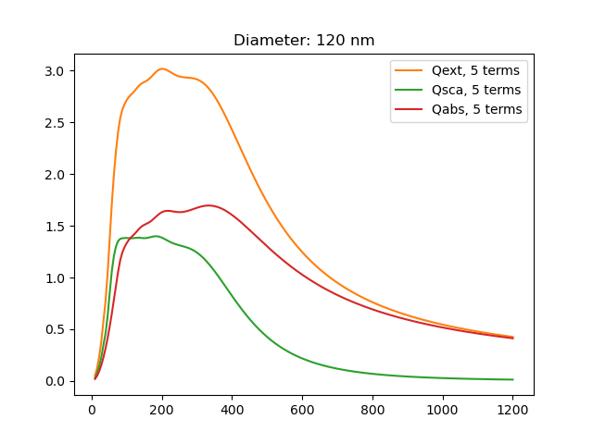
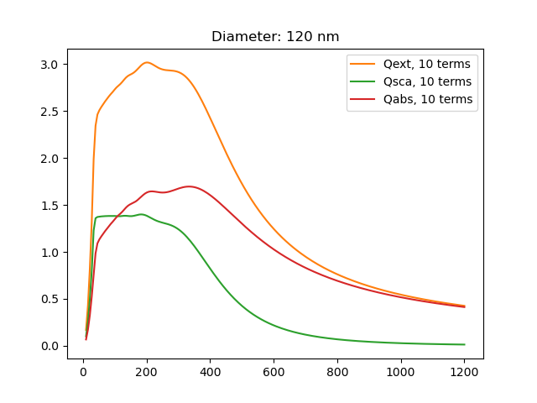
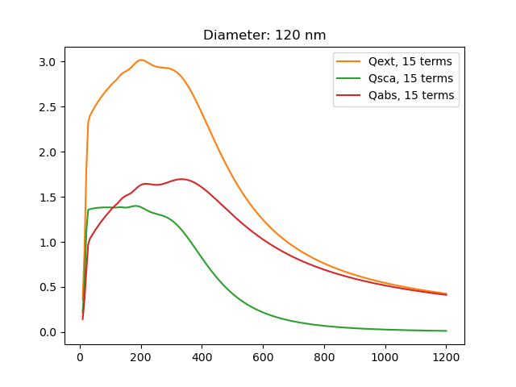
n = 5, 10, 15

Slide 4
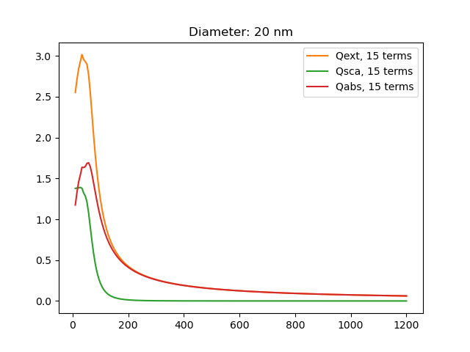
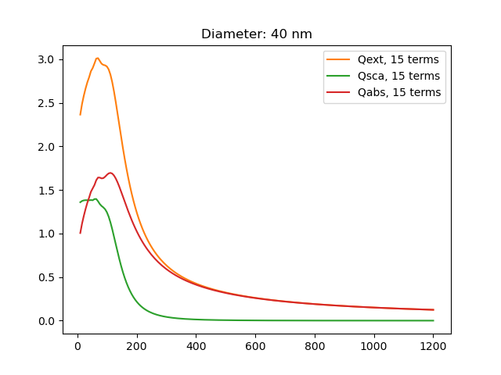
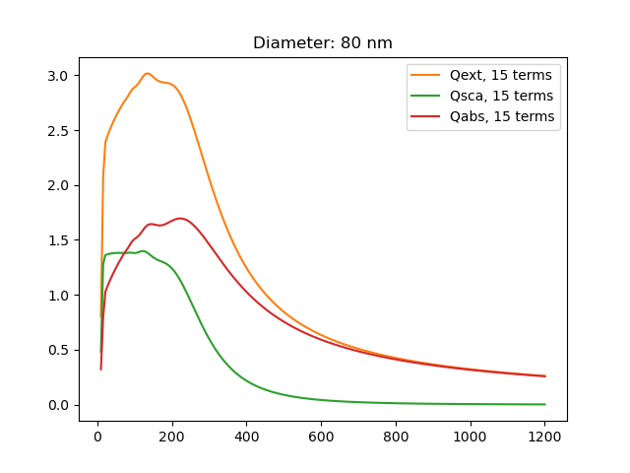
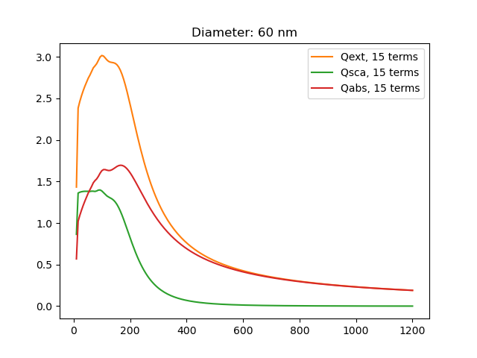
r = 10, 20, 30, 40

Slide 5
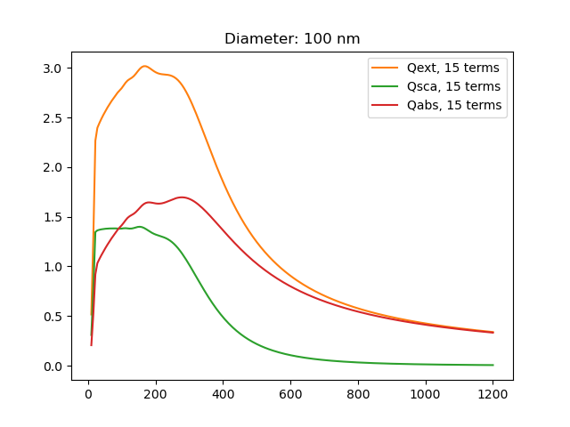
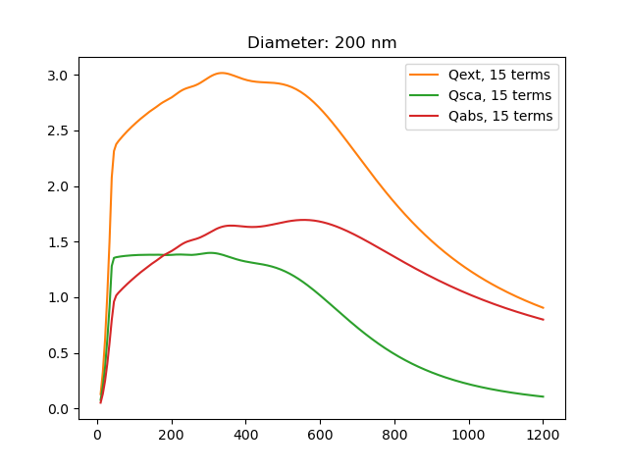
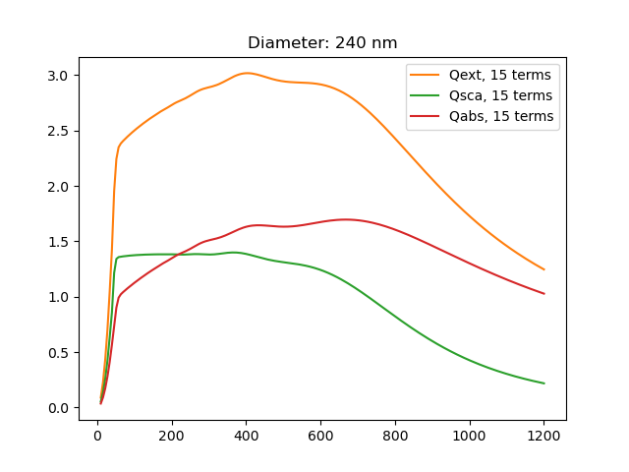
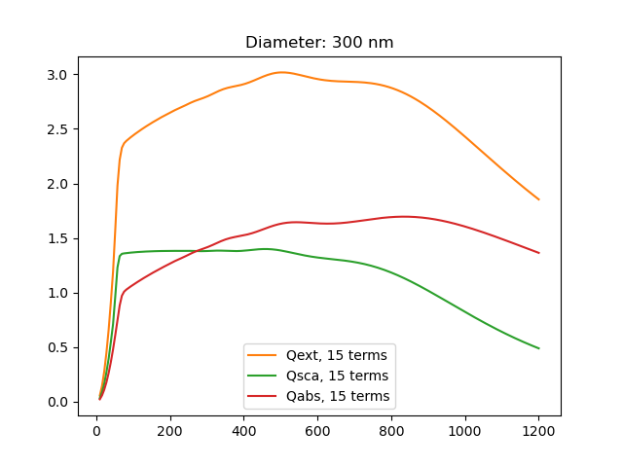
r = 50, 100, 120, 150

Slide 6
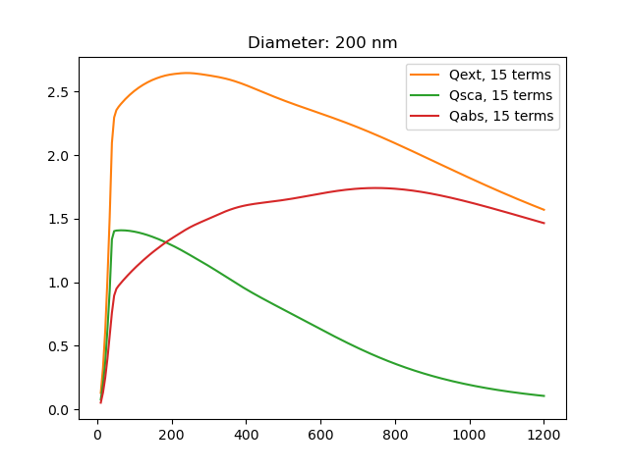
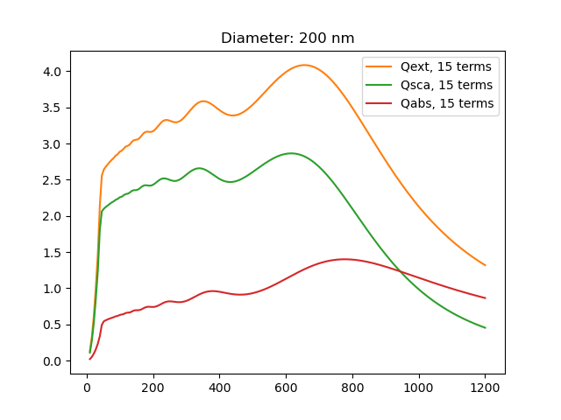
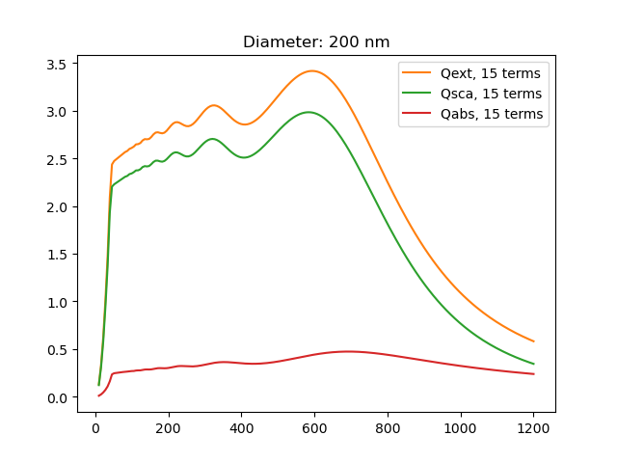
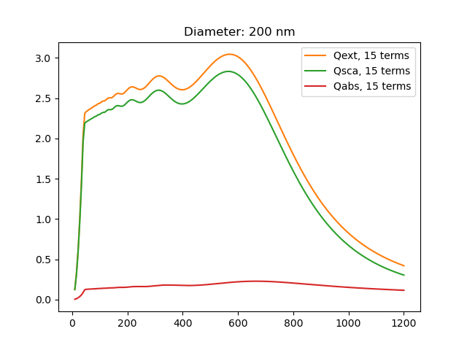

$ε=a+bi$, a = 1, b = 1,3,5,7

Slide 7

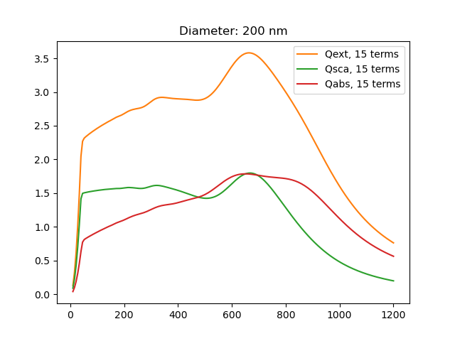
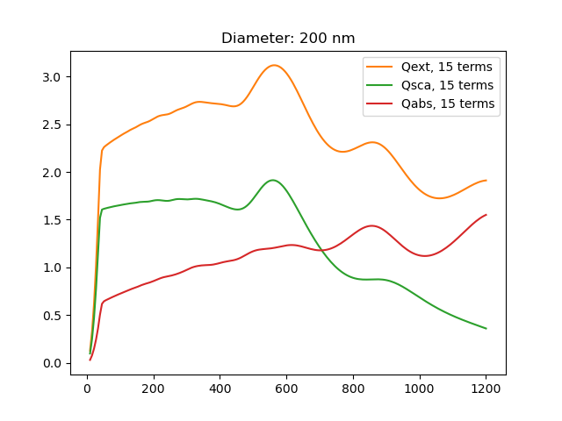
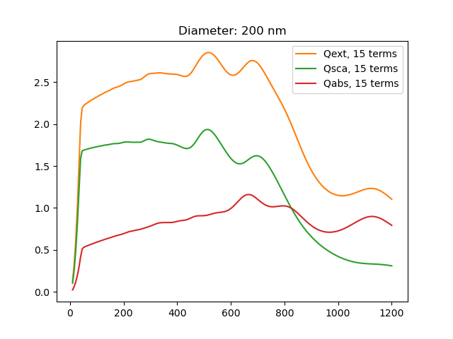

$ε=a+bi$, b = 1, a = 2,4,6,8

Slide 8
Spheroid Ideas
In Bohren &Huffman, wave eqn solved in spherical coords to exploite symm.
We could use a similar method, and follow a parallel method to solve for spheroid

Slide 9
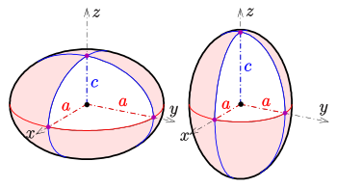
Spheroidal Coordinates
https://dlmf.nist.gov/30.13
Three types of spheroid-esque coordinates
Ellipsoidal
Very complicated, points are doubly degenerate
Prolate/Oblate Spheroidal
Both are the same, defined in terms of circular and hyperbolic trig funcs
All are similar, have been shown to have been separate wave equation, just a question of what we need

